Slide 1
Team 4 ASE Project Increment2
Smart Newspaper
Sravya , Sai Kumar, Prathyusha, Sasleen

Slide 2
Increment 2 updates
Implemented object recognition using Google tensor flow,
text recognition
It recognizes the image when placed infront of the canera and gives the details about the object

Slide 3
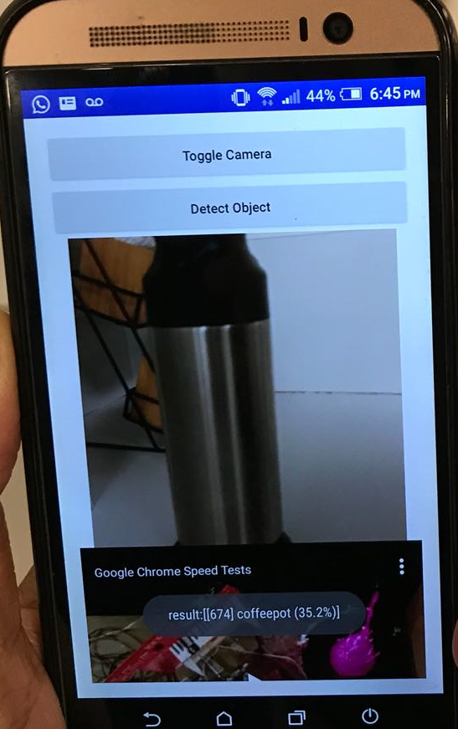
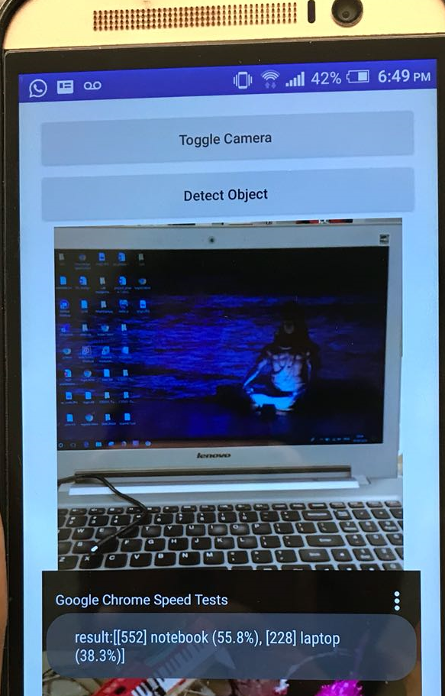

Slide 4
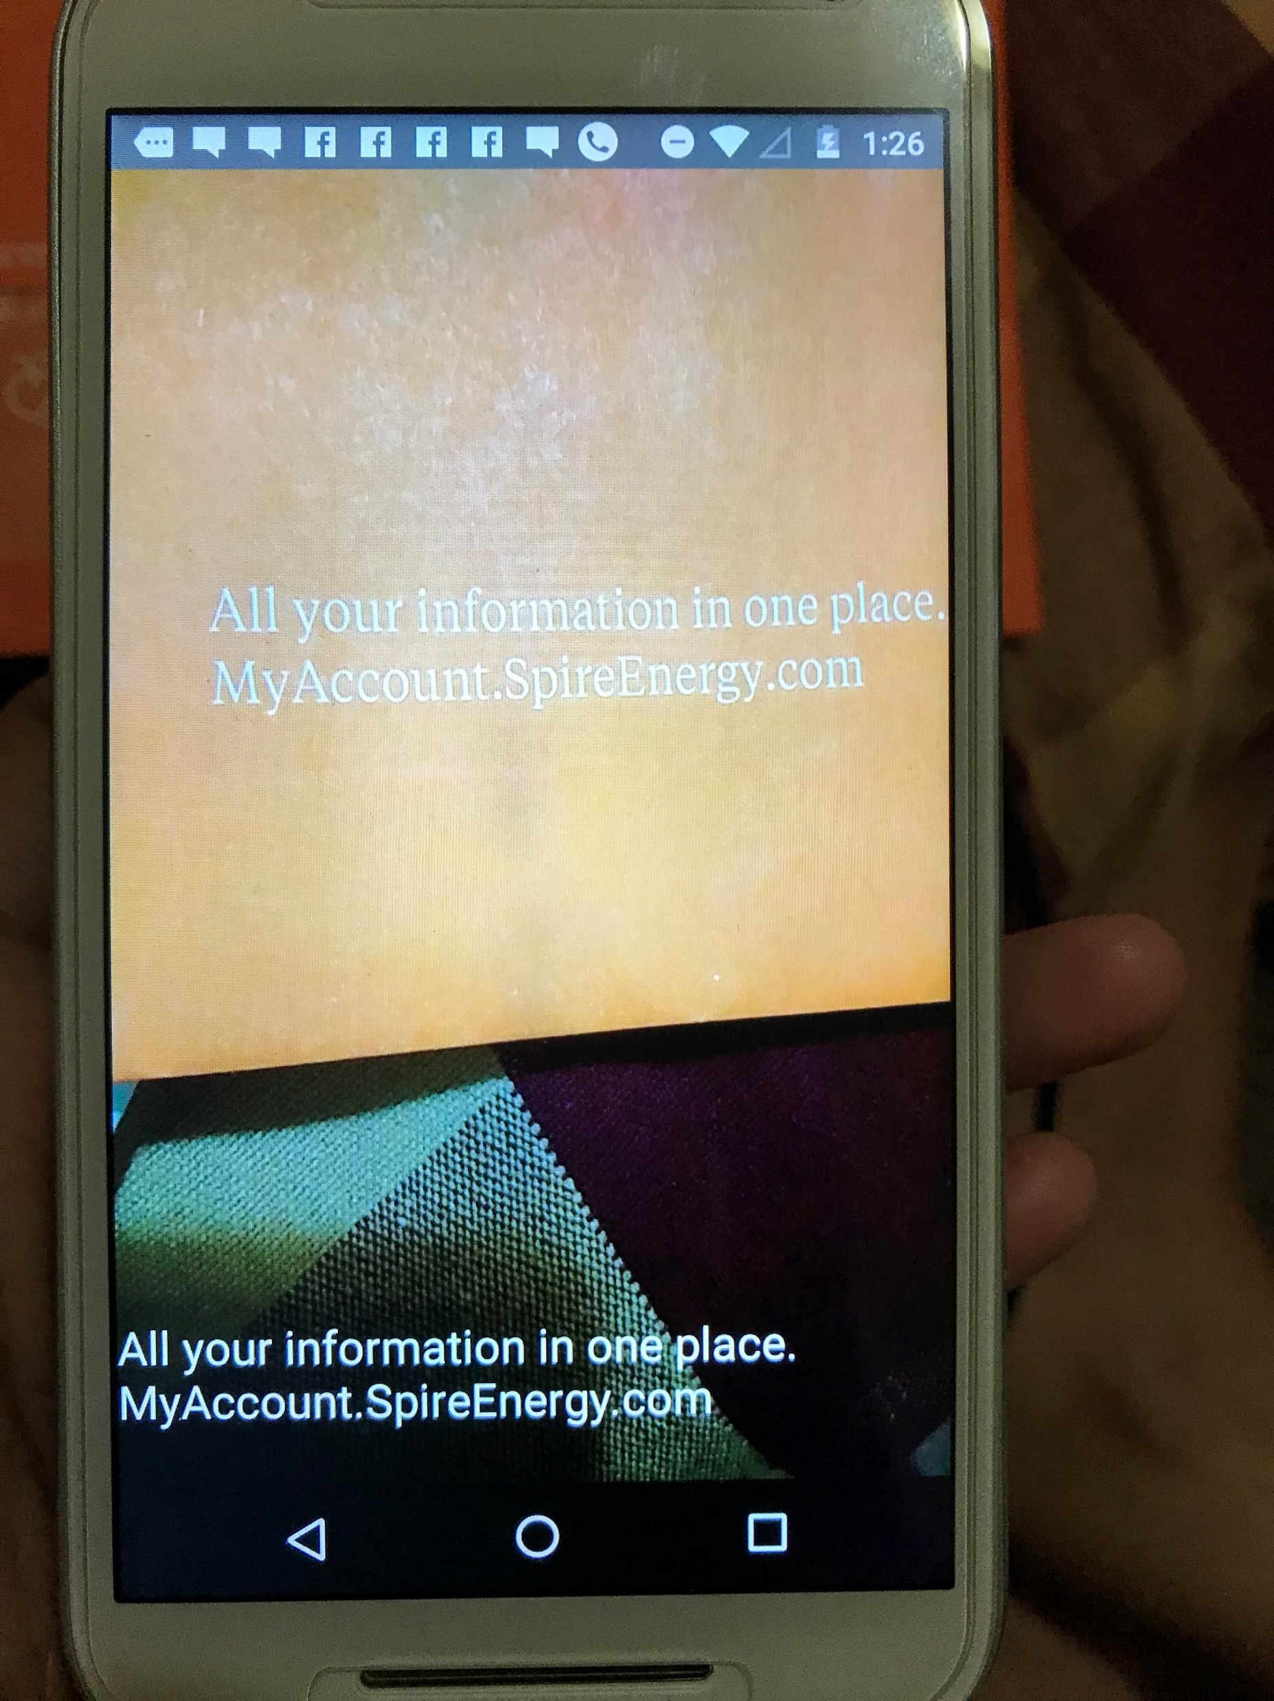

Slide 5
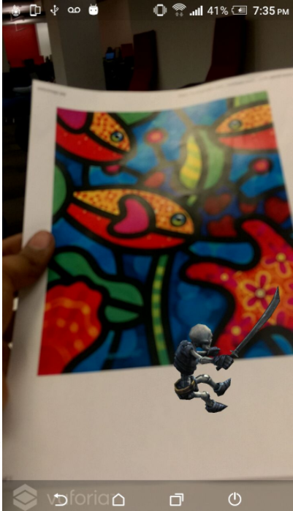
Unity
We tried our 1st attempt in unity by creating a
marker based 3-D model created a 3-D model
such that when the given image is recognized
the 3-D model is popped up.
Our next step would be video playback instead of
a 3-D object

Slide 6
For Increment 3
Link the object and text recognition API to unity such that when the relevant image is scanned the related video is played.

Slide 7
Thank you

